Slide 1
I open source,
and you can too!
Dave Glick
@daveaglick daveaglick.com github.com/daveaglick

Slide 2





Thanks to our sponsors
Platinum
Gold
Bronze
Northern VA CodeCamp Spring 2016

Slide 3

Thanks to host sponsor
Northern VA CodeCamp Spring 2016

Slide 4

What does “open source” mean?

Slide 5
“open source” != downloadable
Notes:
Some may argue, but open source infers collaborative

Slide 6
“open source” != non-commercial
Notes:
Lots of commercial potential in open source
Service contracts, different usage, added features

Slide 7
“open source” != github
Notes:
Came before: Sourceforge, Google Code, Assembla
Currently: BitBucket, GitLab
More will come later

Slide 8
“open source” != git
Notes:
SVN, Mercurial
Some other tech will come in the future

Slide 9
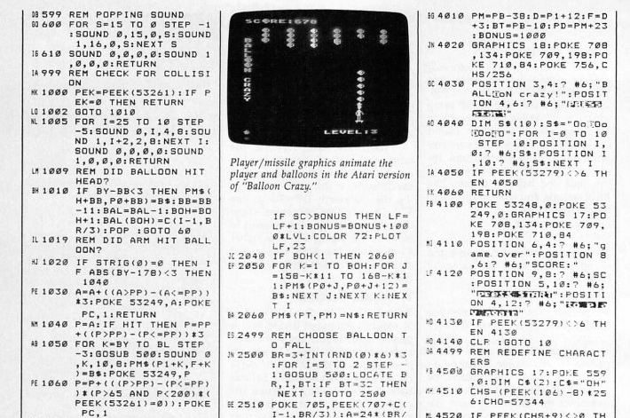
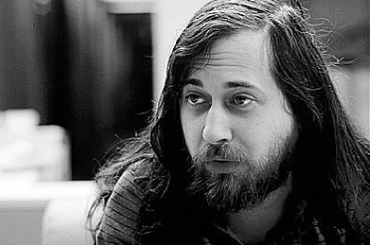
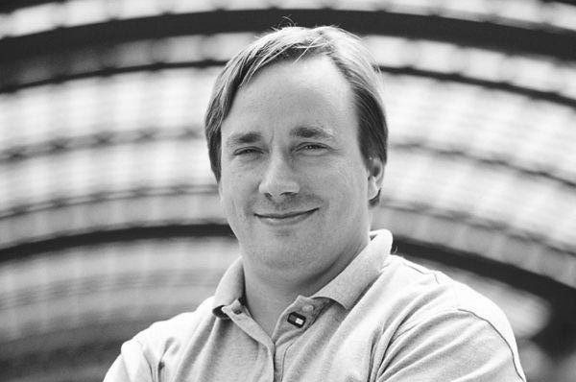
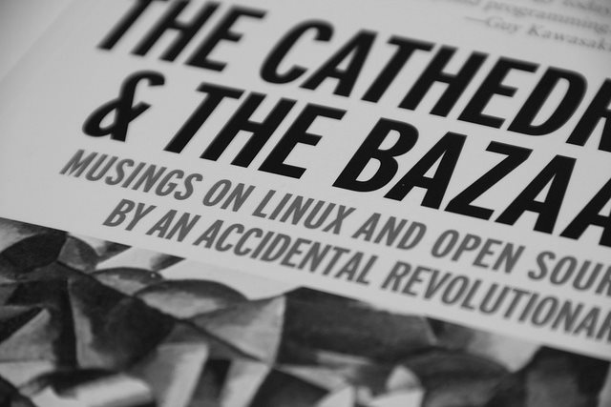
A Brief History of Open Source
Old computer magazines used to have source code that you would hand-type into your terminal.
The GNU project is launched by Richard Stallman in 1983.
The Linux kernel is created in 1991 by Linus Torvalds.
The Cathedral and the Bazaar by Eric S. Raymond is published in 1997.
git is created by Torvalds and other Linux developers in 2005.
GitHub is launched in 2008.
Notes:
This could be a whole talk in and of itself
Linux became the most popular UNIX partly because of more permissive open source model

Slide 10
Types of Open Source Projects
“Source” is used very liberally, we’re not just talking about open source software (OSS)
Applications
Libraries
Documents and books
Presentations
Data sets

Slide 11



Open Source Roles
User
Contributor
Maintainer
Uses open source software (applications or libraries)
Not necessarily a developer
Submits bug reports, feature requests
Contributes code, documentation, etc.
Contributions don’t have to be large
Not necessarily a developer
Primary responsibility for project
Coordinates activities and acts as gatekeeper
Possibly more than one, but probably not

Slide 12
Motivations
Why are you here?
Each role has different motivations
Satisfies a need
Altruism
Recognition
Ego
Creative outlet
Monetary
Do open source for you
Notes:
No motivation is better than any other
Okay to be in it for the money
If you don’t understand your motivation or are doing it for external reasons, will burn out

Slide 13

Am I Good Enough?
Notes:
Imposter syndrome
You’re spending your Saturday at a code camp

Slide 14
Am I Good Enough? YES!
Notes:
Of course you are
Not expected to rewrite NUnit in a day
Open source works due to lots of small contributions
Lots of ways to apply your particular skill set

Slide 15

“…what I do have are a very particular set of skills. Skills I have acquired over a very long career.”
~ Bryan Mills
Notes:
We all have our talents

Slide 16


Open Source Licensing
Not all open source is created equal
Copyleft
Permissive
GPL, LGPL (weak), MPL (weak)
Places stricter requirements on consuming code and users
MIT, BSD, Apache, WTFPL
Better for license compatibility
Not the same as public domain

Slide 17
Open Source Licensing
More things to think about…
Contributor License Agreements (CLA)
Personal vs. business context
Employer’s open source policies (if any)
Distribution vs. internal use

Slide 18
Where To Find Projects and Issues
Stuff you’re already using
Popular projects
CoreFx, ASP.NET, Mvc, Roslyn
Nancy
AutoMapper
Orchard
Umbraco
NUnit
Packet
First Timers Only
http://www.firsttimersonly.com/
first-timers-only issue label
Up For Grabs
http://up-for-grabs.net/

Slide 19

Tools Of The Trade
“…the mechanic that would perfect his work must first sharpen his tools.” - Confucius

Slide 20

What You’ll Need
Git (and GUI)
GitHub
Editor
IDE
Time
Notes:
Using a git GUI is okay, I won’t tell the hard-core hackers
GUIs – Git GUI, SourceTree, GitHub Desktop, SmartGit, built into most editors
Editors – Code, Atom, Sublime, Notepad++
IDE – VS, JetBrains line, etc.
Time – small or large change, need to carve out the time
Can be frustrating if not prepared for follow-through

Slide 21
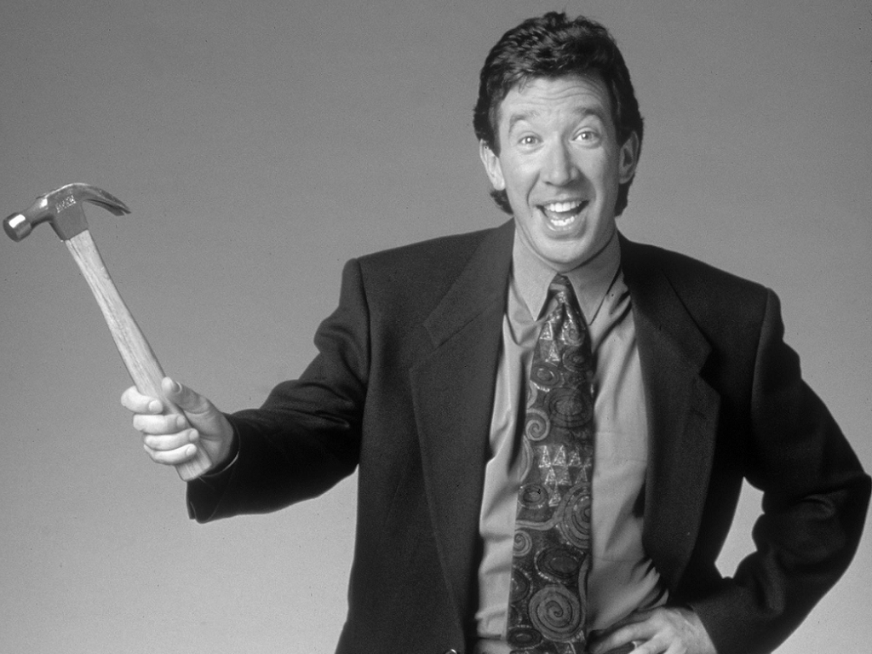
Power Tools
What would Tim the Toolman use for open source?
GitHub Stream
DeckHub (https://getdeckhub.com/)
DevSpace (https://devspace.io/)
Gitter
Podcasts
The Changelog (https://changelog.com/)
FLOSS Weekly (https://twit.tv/shows/floss-weekly)
Mailing Lists
The Changelog Weekly (https://changelog.com/weekly/)
Twitter
@dotnetissues

Slide 22
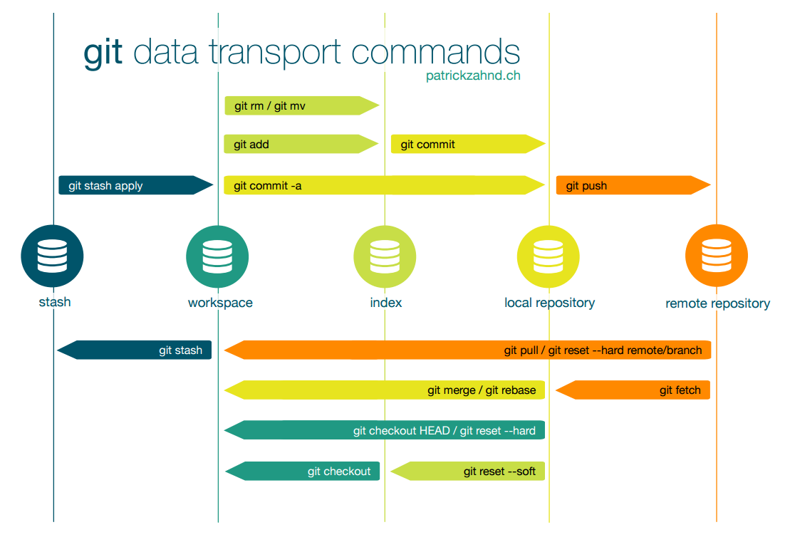
Git Concepts

Slide 23
Git Concepts
Repository
Notes:
local vs. remote

Slide 24
Git Concepts
Repository
Fetch

Slide 25
Git Concepts
Repository
Fetch
Pull

Slide 26
Git Concepts
Repository
Fetch
Pull
Commit

Slide 27
Git Concepts
Repository
Fetch
Pull
Commit
Push

Slide 28
Git Concepts
Repository
Fetch
Pull
Commit
Push
Stash

Slide 29
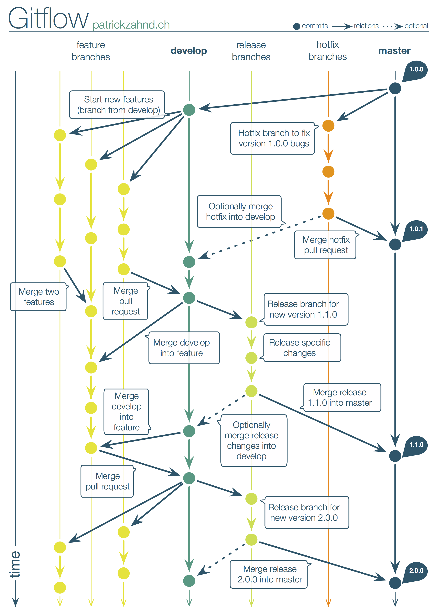
Git Concepts

Slide 30
Git Concepts
Branch

Slide 31
Git Concepts
Branch
Merge

Slide 32
Git Concepts
Branch
Merge
Rebase

Slide 33
Git Concepts
Branch
Merge
Rebase
Tag

Slide 34
Common GitHub Terms
Project
Fork
Issue
Wiki
Pull request
Code review
LGTM

Slide 35
Common Repository Documents
Readme
Purpose of the project
Top-level usage instructions
Where to look for more help
License
Building
What tools are needed
How to conduct a build
Debugging information
Contributing
Conventions to follow
What the process looks like (issue first, etc.)
Testing requirements

Slide 36

Let’s do some open source!

Slide 37
…and speaking of open source
Images from:
https://stocksnap.io
http://www.splitshire.com
https://www.flickr.com/photos/124963567@N02/14334518830
https://www.flickr.com/photos/briannalehman/4341277184
https://www.flickr.com/photos/ericrobinson/6863438497

Slide 38

Thanks.
Contact Me
Dave Glick
@daveaglick daveaglick.com github.com/daveaglick
LGTM

Slide 39
Thanks to our sponsors
Platinum
Gold
Bronze
Northern VA CodeCamp Spring 2016

Slide 40
Thanks to host sponsor
Northern VA CodeCamp Spring 2016

